Slide 1

HOME
ABOUT
MORE
TECHLINK
BRIDGING THE GAP
COURSE: WEB PROGRAMMING – FALL 2025/2026
INSTRUCTOR: DR.ROAA ALSOLOH
PRESENTED BY: ABDULRAHMAN MISTO

Slide 2

HOME
ABOUT
MORE
OBJECTIVE& MOTIVATION
Objective:
Build a dynamic web platform connecting engineers with companies
Allow users to browse engineers, post projects, and communicate
Motivation:
Simplify the recruitment process
Create a real-world portfolio-ready project
Demonstrate full front-end interactivity and data handling

Slide 3
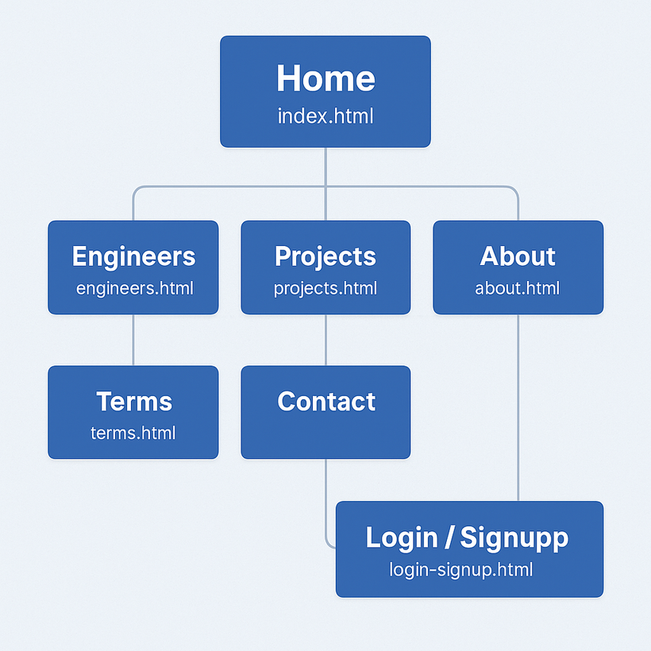
HOME
ABOUT
MORE
SITEMAP
index.html – Homepage, categories, partners, CTA
engineers.html – Engineer listing, search, filters, modals
projects.html – Project posting, browsing, and bidding
login-signup.html – Authentication handling
contacts.html – Contact & support
terms.html / privacy.html – Policies
profile.html – User Profile

Slide 4

HOME
ABOUT
MORE
Login
LIVE DEMO
Contact
Companies
Collaborate
with
Engineers
TECHLINK
Find
Projects

Slide 5

HOME
ABOUT
MORE
CONCLUSION & FUTURE ENHANCEMENTS
Conclusion:
Fully functional front-end web platform
Realistic engineer–company interaction flow
Persistent data handling using JSON + localStorage
Responsive, clean UI with animations
Future Enhancements:
Real backend (Node.js / Firebase / PHP)
Encrypted user accounts & authentication
Engineer dashboard + real-time chat
File upload for project attachments
Notification system and admin panel

Slide 6
HOME
ABOUT
MORE
THANK YOU.
COURSE: WEB PROGRAMMING – FALL 2025/2026
INSTRUCTOR: DR.ROAA ALSOLOH
PRESENTED BY: ABDULRAHMAN MISTO

